Slide 1

Management of Data Science and Business Workflows
Project on Responsible Data Science Noor ul Hassan Kashif Nawaz Imad Sharof Aakash Karki Hatim Draoui

Slide 2

Goal
Understand and evaluate how responsible data science principles affect an ML model predicting “>50K” income on the Adult dataset.
Several responsible data science aspects of the ML pipeline have been investigated during this project.

Slide 3
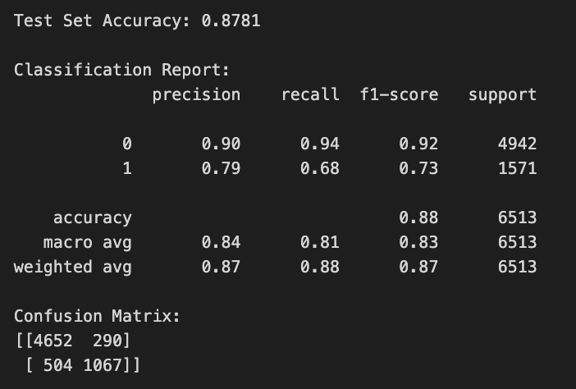

Classification
The methodology was structured around four pivotal steps:
Data Pre-processing:
Imputation Strategy
Age Binarization
Label Encoding
Partitioning:
Training set: 60%
Validation set: 20%
Test set: 20%
Model Selection: XGBoost (eXtreme Gradient Boosting) classifier
Performance Evaluation:
Accuracy : Global Accuracy of 87.81%
Confusion Matrix Analysis
Class Imbalance

Slide 4
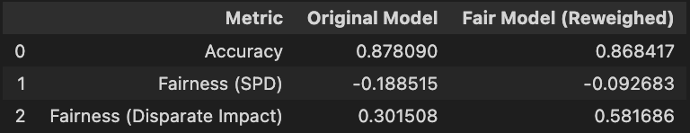
Fairness Analysis
The objective of this stage was to rigorously evaluate and mitigate algorithmic bias within our classification model.
AIF360 library, focusing on two protected attributes : Age and Sex.
Metric Selection and Baseline Evaluation:
Selected the Statistical Parity Difference (SPD)
SPD= P(Y=1| Unprivileged – P(Y=1|Privileged)
A perfect model has 0 SPD but our model ha value -0.1885.
Bias Mitigation Strategy :
Implemented pre-processing reweighing
Post-Mitigation Performance and Trade-off :
It improves the SPD from -0.1885 to 0.0927.
The classification accuracy decreased marginally from 87.81% (Original) to 86.84% (Fair)

Slide 5
Local Differential Privacy (LDP)
Objective : Protect sensitive data before data collection
Problem : Standard anonymization isn't enough; unique combinations can re-identify users.
Solution : Local Differential Privacy (LDP)
Noise is added locally on the user's device
The database curator never sees the raw truth
Provides "Plausible Deniability" to every individual

Slide 6
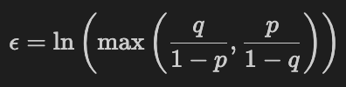
Randomized Response (Coin flip method)
Parameters :
Truth probability : 75%
Noise probability : 25%
Privacy Budget (ϵ) :
Resulting epsilon ϵ ≈ 1.1
Represents a strong balance between privacy protection and data utility

Slide 7
Data Utility: The Cost of Privacy
Measuring Distortion : Comparing Real Data vs Noisy Data
Statistical Error:
Mean Absolute Error (MAE) : ~ 1,420 records
Relative Error : ~ 4.36%
Observation : While individual records are unreliable, the aggregate distribution remains largely intact.

Slide 8
Model Robustness and Conclusion
Impact on AI model :
Original Accuracy : 87.81%
Private Accuracy : 87.30%
Performance Drop : < 0.6%
Key Takeaway :
The model is highly robust
Even with ~25% noise on sensitive features the classifier effectively predicts income using other signals.
Conclusion : We successfully achieved privacy without destroying business value

Slide 9
Explainability of the Private Classifier
Understand why the private classifier makes wrong but highly confident predictions
Analyse the role of noisy Age and Sex (protected with Local DP)
Use explainability tools to diagnose model behaviour

Slide 10
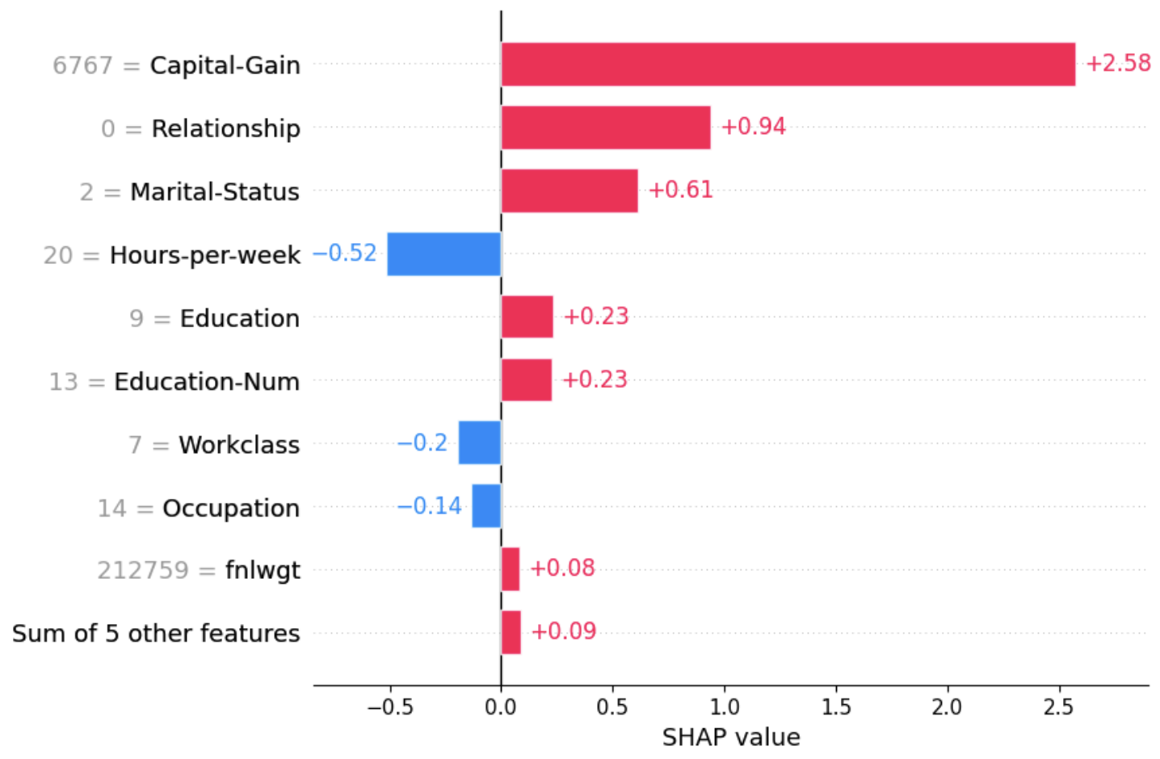
Top contributing features
Top contributing features in errors:
capital-gain
hours-per-week
noisy Age
noisy Sex
Perturbed Age often moved people into older age bins → pushes probability upward
Perturbed Sex often flipped female → male → increases predicted income

Slide 11

Explainability and LLMs
Goal: The objective of this part was to automatically interpret SHAP insights and generate human-readable explanations with a local LLM.
LLM-Based SHAP Explanation System:
Automates translation of SHAP insights into human explanations
Python extracts top SHAP drivers for each prediction
Local LLM interprets feature impacts like an “AI analyst”

Slide 12
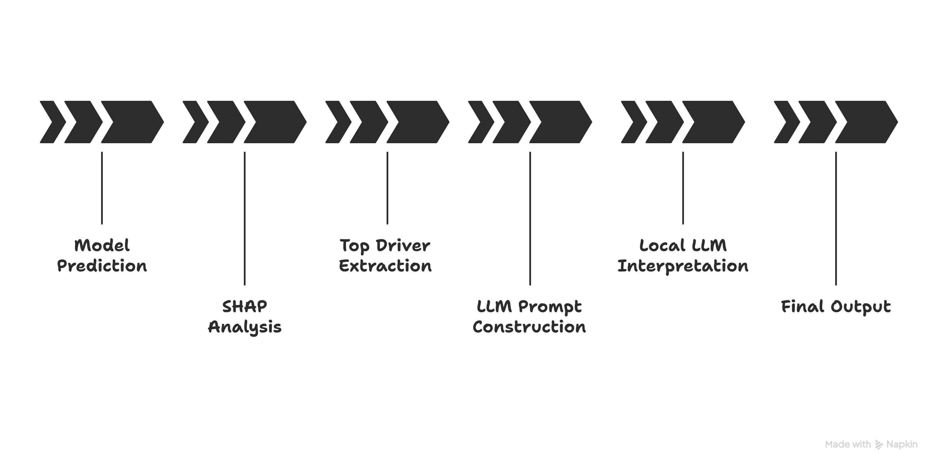
Explainability and LLMs
End-to-End Dynamic Explainability:
Identifies top 3 features influencing the prediction
Automatically detects the most impactful driver of the error
LLM generates clear, polite customer-facing explanations
Fully automated workflow: no manual analysis needed

Slide 13
Free exploration : Intersectionality analysis
Beyond Single Attributes : we moved from analyzing "Sex" or "Race" in isolation to studying Intersectional Subgroups (Race + Sex) and see what happens
Statistical Surprise (The 1994 Data Bias):
Asian-Pac Males have the highest probability of being predicted as "Rich," surpassing even White Males
Context: This reflects the 1990s US skilled immigration policies, creating a "Model Minority" statistical effect in this specific dataset.

Slide 14
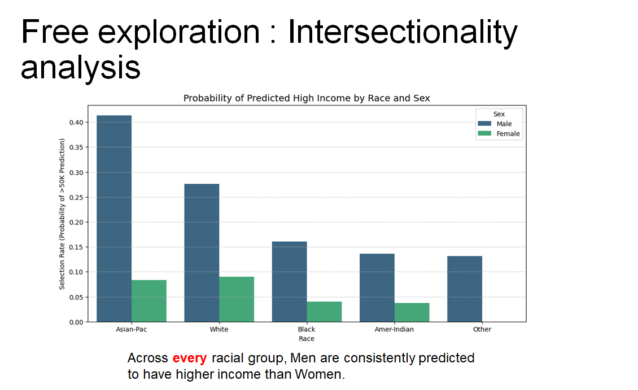
Free exploration : Intersectionality analysis

Slide 15
Thank you for listening !

